Slide 1
Oligopoly and Strategic Behavior

Slide 2
Oligopoly -Characteristics
Few sellers of a product
Duopoly - Two sellers
Pure oligopoly - Homogeneous product
Differentiated oligopoly - Differentiated product
Non-price competition
Barriers to entry
High degree of interdependence between firms
Abnormal profits
Potential for collusion

Slide 3
Measuring Market Concentration
Concentration ratio: the percentage of the market’s total output supplied by the largest firms (usually the four largest).
The higher the concentration ratio, the less competition.

Slide 4
Concentration Ratios in Selected U.S. Industries
0
Industry | Concentration ratio
Video game consoles | 100%
Tennis balls | 100%
Credit cards | 99%
Batteries | 94%
Soft drinks | 93%
Web search engines | 92%
Breakfast cereal | 92%
Cigarettes | 89%
Greeting cards | 88%
Beer | 85%
Cell phone service | 82%
Autos | 79%
Notes:
4
Sources: U.S. Census Bureau (www.census.gov), Federal Trade Commission (www.ftc.gov), and various periodicals and microeconomics textbooks.

Slide 5
Models of Oligopoly Behavior
No single general model of oligopoly behavior exists.
Stackelberg Model
Bertrand Model
Cournot Model
Sweezy (Kinked-Demand) Model

Slide 6

Stackelberg Model
The Stackelberg leadership model is a strategic game in economics in which the leader firm moves first and then the follower firms move sequentially.

Slide 7
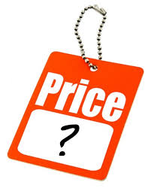
Bertrand Model
The Bertrand duopoly model examines price competition among firms that produce differentiated but highly substitutable products.

Slide 8
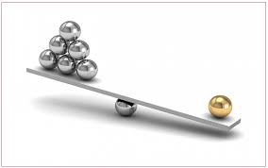
Cournot Model
Cournot competition describes a market structure in which companies compete on the amount of output they will produce, which they decide on independently of each other and at the same time.

Slide 9
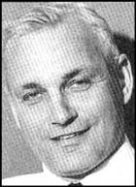
Kinked Demand Curve Model
Proposed by Paul Sweezy
If an oligopolist raises price, other firms will not follow, so demand will be elastic
If an oligopolist lowers price, other firms will follow, so demand will be inelastic
Implication is that demand curve will be kinked, MR will have a discontinuity, and oligopolists will not change price when marginal cost changes

Slide 10
Price
Kinked Demand Curve
Rs 5
D = elastic
Kinked D Curve
D = Inelastic
100
Quantity

Slide 11
MC’
MC
MC’’

Slide 12
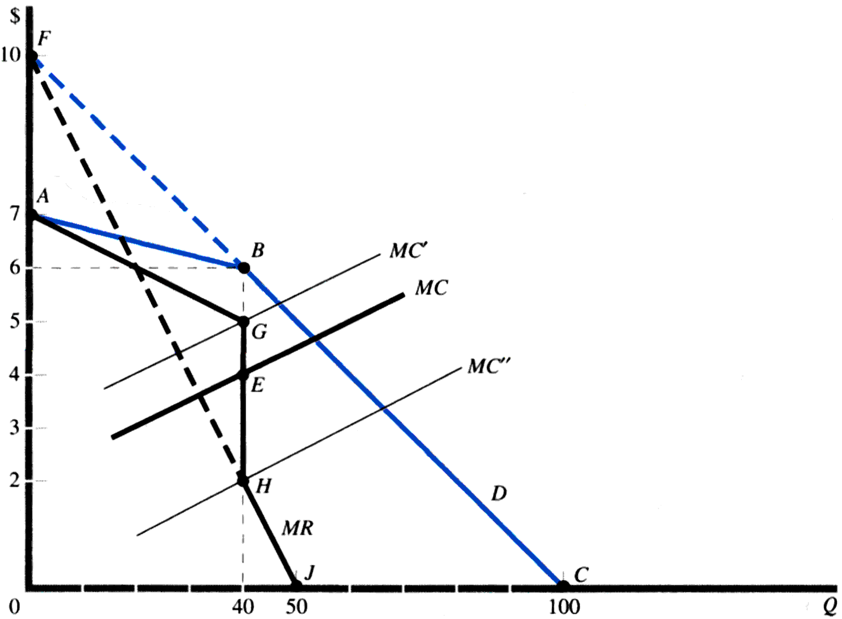
Kinked Demand Curve Model

Slide 13
Criticism
No evidence that price increase is not matched.
Unable to tell the price at which the kink will occur.

Slide 14
Cartels
Collusion
When a small number of firms share a market, they can increase their profit by forming a cartel and acting like a monopoly.
Collusion can be: overt or explicit and tacit or implicit
Explicit collusion is called cartel. It is a group of firms acting together to limit output, raise price, and increase economic profit. For example, Mumbai Taxi Association, OPEC etc.
Implicit collusions are known as price leadership models.
Collusions are illegal but they do operate in some markets.

Slide 15
Cartels
Market-Sharing Cartel
Collusion to divide up markets on the basis of geographical area
Centralized Cartel
Formal agreement among member firms to set a monopoly price and allocate output among its members and determine how profits are to be shared.
Example: OPEC

Slide 16
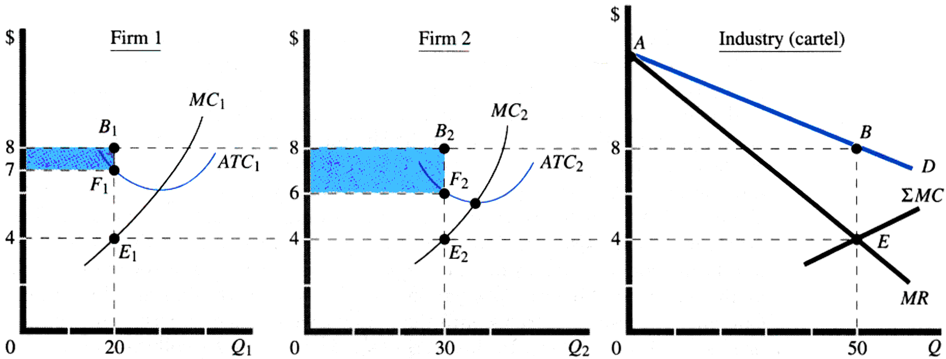
Centralized Cartel

Slide 17
Weakness
Firms can ask for an equitable distribution of profits.
Cartel members have a strong incentive to cheat by selling more.
Monopoly profits may attract other firms.

Slide 18
Oligopoly vs. Other Market Structures
Oligopoly presents the greatest challenge to economists
essence of oligopoly is strategic interdependence
economists have had to modify the tools used to analyze other market structures and to develop entirely new tools as well
One approach—game theory—has yielded rich insights into oligopoly behavior

Slide 19
ROLE OF THE COMPETITION COMMISSION OF INDIA
The Competition Commission of India is a body of the government of India that is responsible for enforcing the Competition Act 2012.
This act is there to prevent activities that have an adverse effect on competition and was established in October 2003. The Competition Act, 2002, as amended by the Competition (Amendment) Act, 2007, follows the philosophy of modern competition laws.
The act prohibits anti-competitive agreements, abuse of dominant position by enterprises and regulates combinations, which cause or are likely to cause an appreciable adverse effect on competition within India

Slide 20
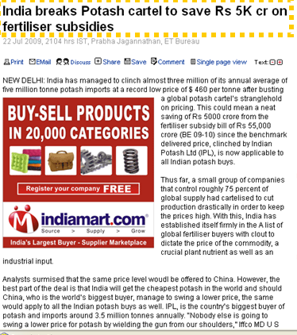

Slide 21
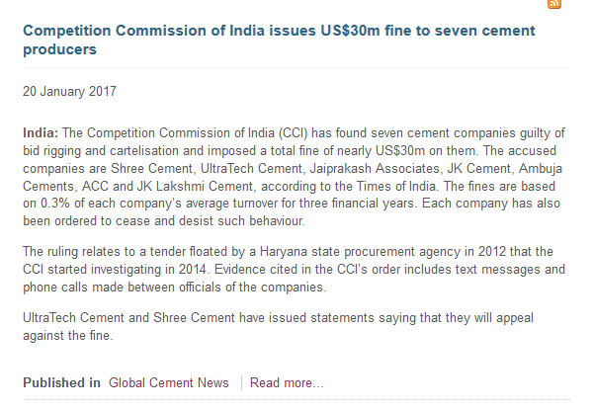

Slide 22
There's a new cartel in town: Insurance firms
By
Shilpy Sinha
ET Bureau | Updated: Feb 22, 2017, 08.58 AM IST
MUMBAI: General insurers are coordinating product design and premiums by sharing data on occupancies where claims are high in what experts call the first signs of cartelisation of the industry which could have a big impact on customers and it is likely that the Competition Commission of India (CCI) intervenes. The uniform wordings on policy documents for industries such as steel and power and identical premium rate and deductible may invite the attention of the monopoly watchdog. The CCI had come down heavily on the tyre and cement industries for their cartel model which fleeced customers. The general insurance sector has come together to follow uniform premium rate and deductible for seven industries and add another five in the next financial year. Insurers have decided minimum premium rates that will be charged in case of seven industries including paper, cement, tyre, ITsoftware and aluminium, zinc and copper. The industry has also decided that expiring lead insurer would notify other insurers about claim experience of previous years. “The industry has decided to not charge rates that are unsustainable,“ said A Hoda, officiating chairman, United India. “Nobody is going to charge below a certain percentage because competition is leading to death of the industry.“ “The industry has come together to jack up prices and kill free pricing,“ said head of an insurance bro king firm. “This is violation of free market."

Slide 23
Ajay Devgan sued YRF for unfair competition
Ajay Devgn Films (ADF) have served Yash Raj Films (YRF) a notice in the Competition Commission for using their dominant position in the Bollywood film market.
And, using and abusing their clout to deny ADF their rightful due, for ADF’s November 13, Diwali release, Son Of Sardaar.
Before the release of Ek Tha Tiger, in August 2012, YRF had reportedly used their dominant position in the market to enter into an arrangement with the exhibitors saying that they will give them Ek Tha Tiger only if the exhibitors agreed to reportedly give their Diwali release prominence over others.’’

Slide 24
The price of Kajuroll is currently at Rs 400 per kg. Kamath sweets faces a kinked demand curve with a demand equation P= 600- 0.5Q for prices above Rs 400 and
P= 700- 0.75Q for prices below Rs 400. The firm’s marginal cost surve is given by an equation with the general form
MC= a + bQ
If a=50 and b= 0.25, graph the demand , MR and MC curves.
Determine the profit-maximizing output.
Starting from a=50, how much can the constant term of the marginal cost equation increase before the profit-maximising quantity decreases? How much can the coefficient decrease before the profit maximizing quantity increases?

Slide 25
In an oligopolistic industry, the other firms do not respond to changes in price of a firm’s product, the demand curve is Q= 700-50P. However, if other firms always match the firm’s price , the demand curve is Q = 200-10P.
Calculate profit maximizing quantity and price-
If MC= 8.00
If MC= 11.50

